Slide 1
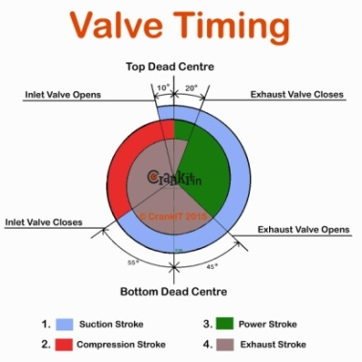
Variable Valve Timing
ME 3504: Electronic Management
of Engines
Clint Antony
131501008

Slide 2
Variable Valve Timing
It is the process of altering the timing of a valve lift event, and is often used to improve performance, fuel economy or emissions.
There are many ways in which this can be achieved, ranging from mechanical devices to electro-hydraulic and camless systems.

Slide 3
The Need ..
Valves control the breathing of the engine – controls the flow of intake and exhaust gases in and out of the combustion chamber.
Without variable valve timing, the valve timing (w.r.t a reference in a cycle) will be same for all engine speeds and conditions which can greatly affect the performance.
As the speed of the engine becomes higher, the valves tend to open and close very quickly allowing less amount of air to enter into the combustion chamber. (solution: racing cam)
But in order to increase the inlet valve open duration, advancing the opening of the inlet valve increases the valve overlap duration causing the unburnt fuel to escape the engine causing pollution and low performance.

Slide 4
Valve Overlap
LESS
Smooth idle
More slow speed torque.
MORE
Rough idle (dilution of mixture)
Higher exhaust emissions (LS)
Less scavenging (HS)
Better engine breathing (HS)
Notes:
HS – High Speed

Slide 5
Effects of Timing Adjustment
Late intake valve closing:
Reduces pumping loses by 40% during partial load conditions
Decrease nitric oxide (NOx) emissions by 24%.
Peak engine torque showed only a 1% decline
Hydrocarbon emissions were unchanged.
Early intake valve closing:
Early intake valve closing reduces pumping losses by 40%
Increases fuel economy by 7%.
It also reduced nitric oxide emissions by 24% at partial load conditions.
A possible downside to early intake valve closing is that it significantly lowers the temperature of the combustion chamber, which can increase hydrocarbon emissions.
Source:Hong, H. (2004). Review and analysis of variable valve timing strategies - eight ways to approach. Proceedings of the Institution of Mechanical Engineers, Part D: Journal of Automobile Engineering, 218(10), 1179-1200.

Slide 6
Effects of Timing Adjustment
Early intake valve opening:
Early intake valve opening is another variation that has significant potential to reduce emissions.
Controls the temperature and hence the NOx emissions.
Improves volumetric efficiency, because there is less exhaust gas to be expelled on the exhaust stroke.
Early/late exhaust valve closing:
Early and late exhaust valve closing can also reduce emissions.
By holding the exhaust valve open slightly longer, the cylinder is emptied more and ready to be filled with a bigger air/fuel charge on the intake stroke.
By closing the valve slightly early, more exhaust gas remains in the cylinder which increases fuel efficiency. This allows for more efficient operation under all conditions.
Hong, H. (2004). Review and analysis of variable valve timing strategies - eight ways to approach. Proceedings of the Institution of Mechanical Engineers, Part D: Journal of Automobile Engineering, 218(10), 1179-1200.
Notes:
helloooooo

Slide 7
Methods of Implementing VVT
Cam Switching
Cam Phasing
Oscillating Cam
Eccentric Cam Drive
Three Dimensional Cam Lobe
Two shaft combined Cam Lobe
Co-axial Two shaft combined Cam Lobe
Helical Camshaft
Camless Engines

Slide 8
Cam Switching For example:Honda VTEC
Uses two cam profiles and an actuator to swap between the profiles.
Provides variable valve lift and duration.
Discrete control.

Slide 9
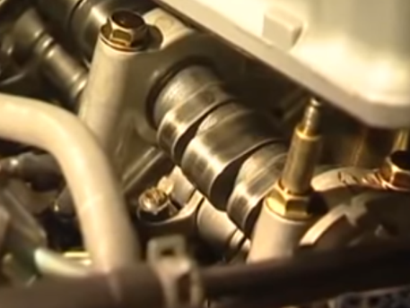
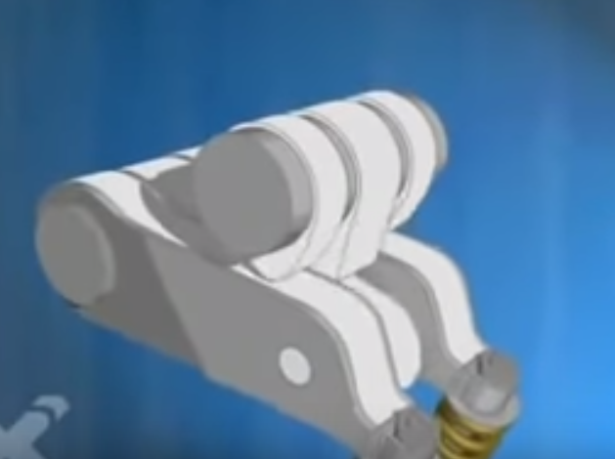
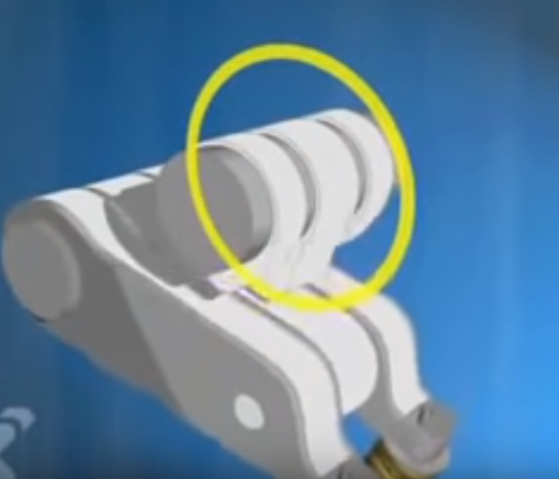
VTEC
Variable Valve Timing & Lift Electronic Control
Discrete control.

Slide 10
Cam Switching

Slide 11
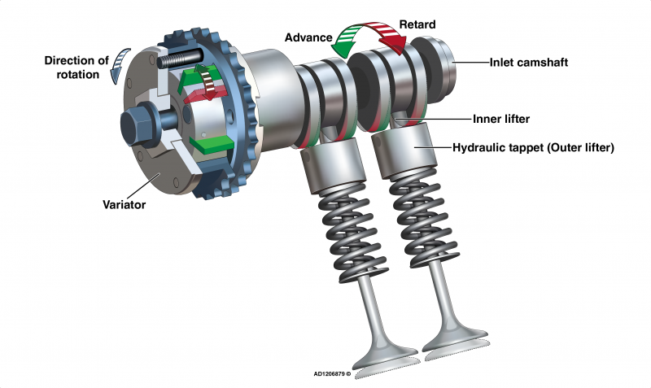
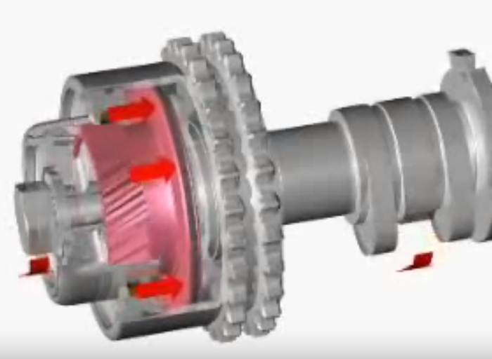
Cam Phasing
Phase angle of the cam shaft is changed.
Provides continuous control.
Duration and lift cannot be adjusted.

Slide 12
Automotive Nomenclature
VarioCam (Porsche)
VTEC, i-VTEC (Honda)
Valvelift (Audi)
AVCS (Subaru)
VANOS (BMW)

Slide 13
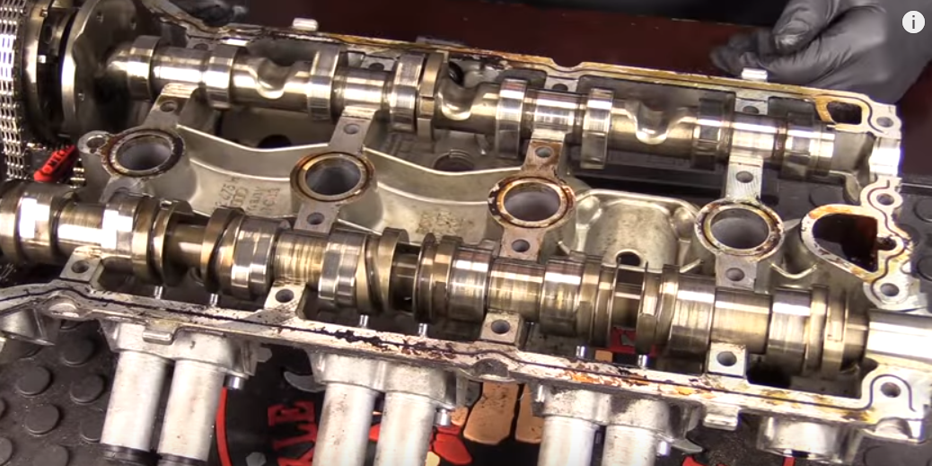
Audi A4 (2009)
Exhaust and Intake cam (from below)

Slide 14
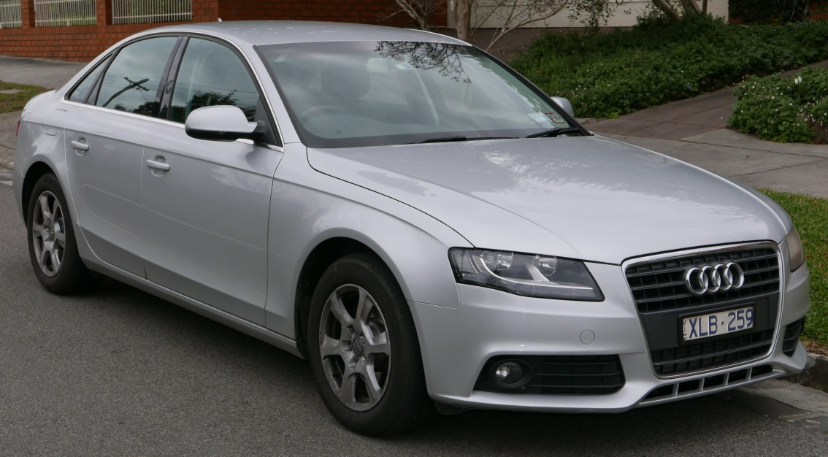
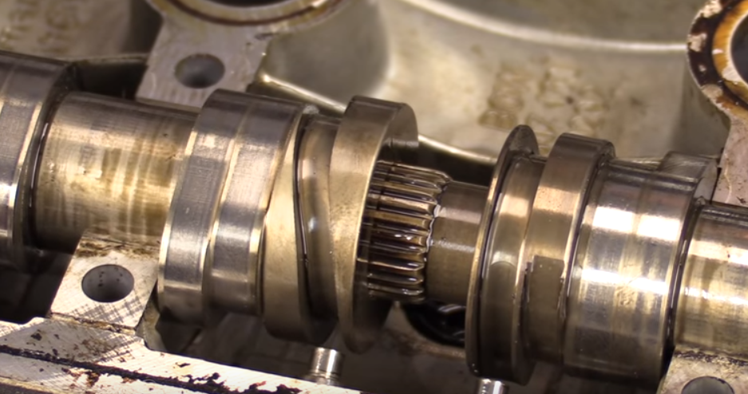
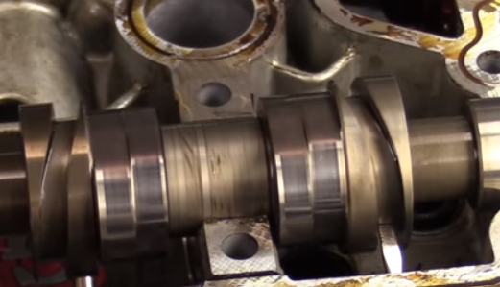

Slide 15
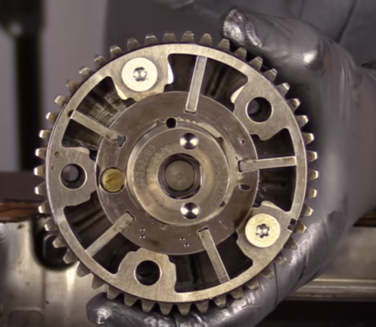
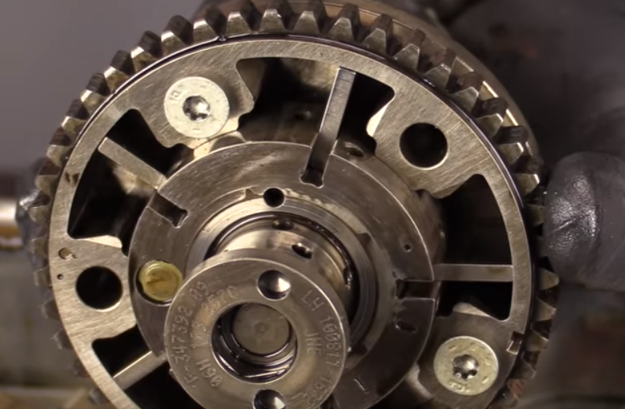
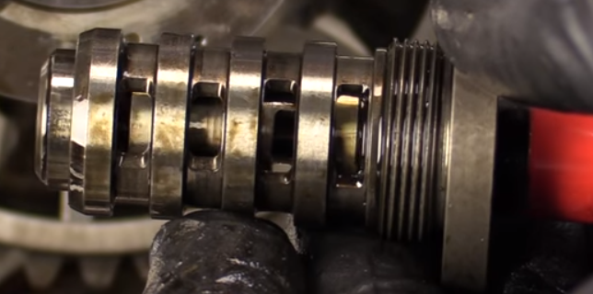

Slide 16

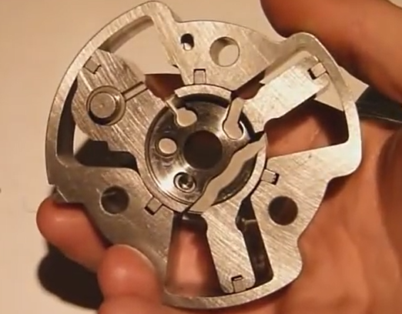
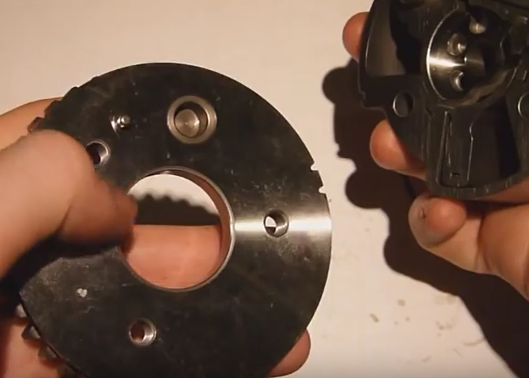
Nissan HR16DE

Slide 17
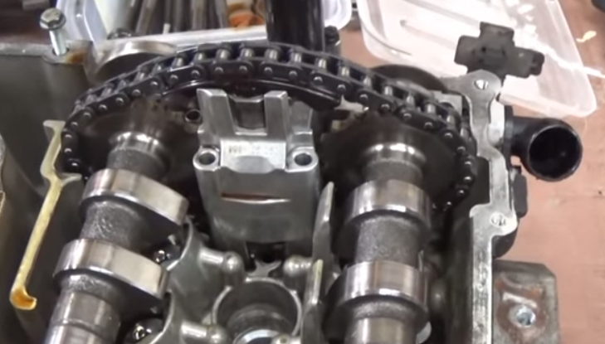
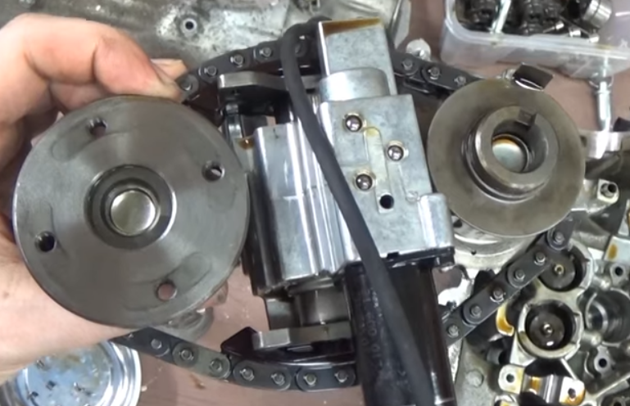
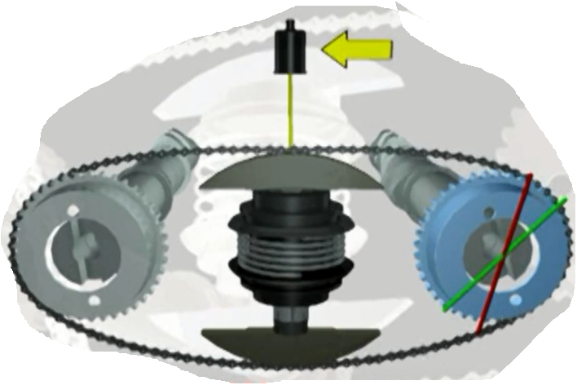
Variocam (Porsche 996 Engine)

Slide 18
VVT-i (Toyota)

Slide 19
To Design an Approximate Model

Slide 20
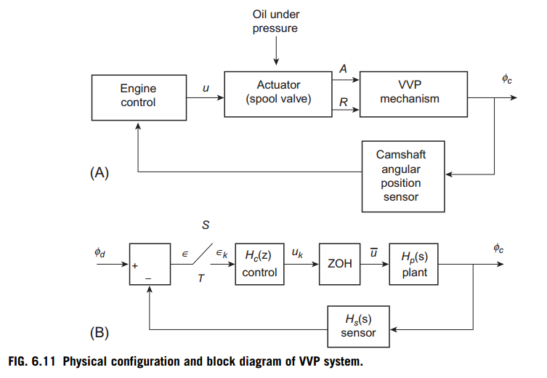
Block Diagram:

Slide 21
Sensors
MAP or MAF sensor
Engine Speed (RPM ) sensor (non contact)
Angular Position sensor (non contact )
Hall Effect sensor
Magnetic Reluctance sensor

Slide 22
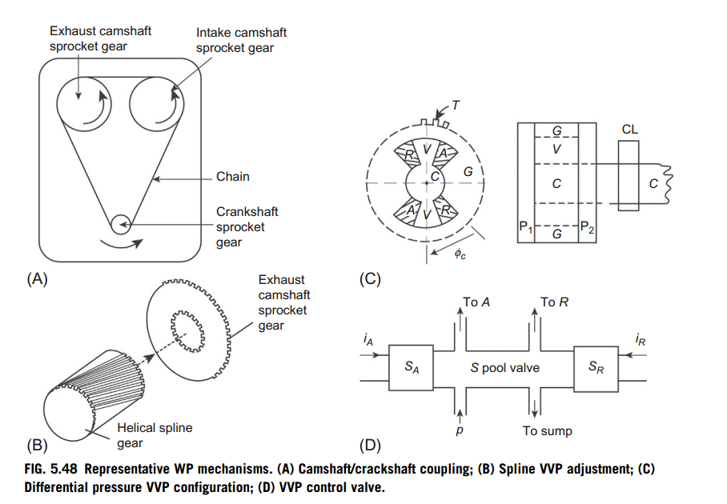
Designing a model:

Slide 23
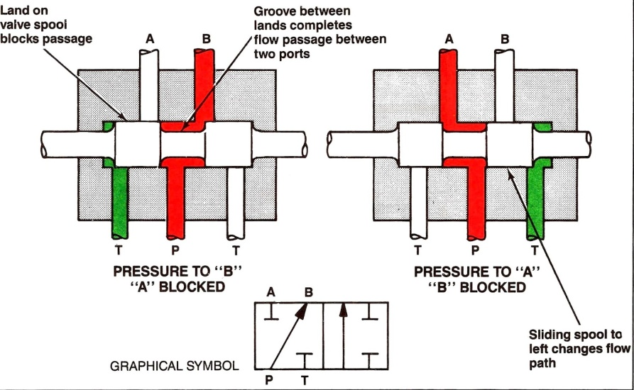
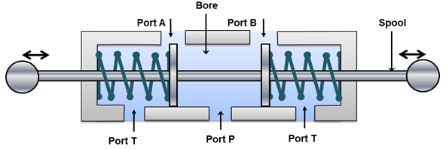
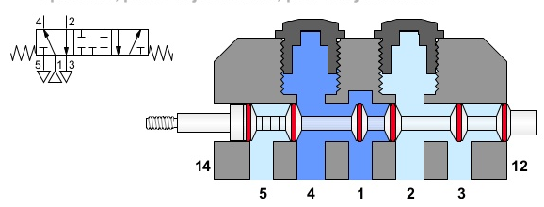
Spool Valve

Slide 24
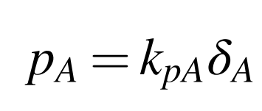
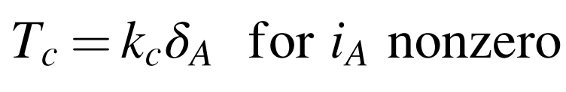
Actuator Design:
Displacement of the spool valve (xA) is proportional to the duty cycle (δA) of the pulsed current (iA).
The pressure in chamber A denoted pA (for a given supply pressure from the main oil galley) is proportional to spool valve displacement, which is proportional to δA. The model for chamber A pressure is given by
The torque acting on the camshaft to advance the cam phase Tc is given by where kc is the constant for the geometry and for constant oil supply pressure

Slide 25
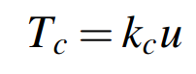
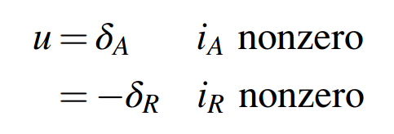
Actuator Design:
For a linear actuator; u being the electronic signal from the ECU:

Slide 26
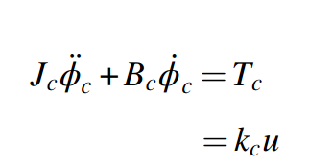

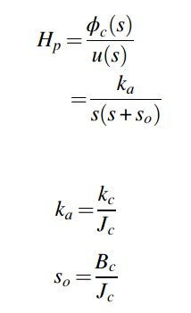
Dynamic motion can be represented as:

Slide 27
Block Diagram:

Slide 28
Input Signal:
Optimal overlap is a function of rpm and load and is decided by engine mapping.
Desired phasing is stored in the ROM in the ECS for the RPM and load – making the lookup table and used with interpolation.
RPM Measured using any non contact sensor while load is measured using MAF and RPM or MAP.
Based on the data, the control unit sends the appropriate signal.
The actual phase difference is measured by using an angular position sensor on camshaft and its drive gear.

Slide 29
Constraints of VVP
Should respond quickly to the fluctuating load and RPM conditions.
Less overshoot and no steady state offset.
Robust with respect to the oil viscosity (temperature)

Slide 30
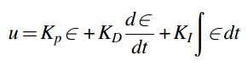
PID Control is used:
After this, time discretisation model is applied to determine uk .
The zero-order hold (ZOH) is a mathematical model of the practical signal reconstruction done by a conventional digital-to-analog converter (DAC). That is, it describes the effect of converting a discrete-time signal to a continuous-time signal by holding each sample value for one sample interval.
After the signal processing part, the various parameters are optimised to get the output response.

Slide 31
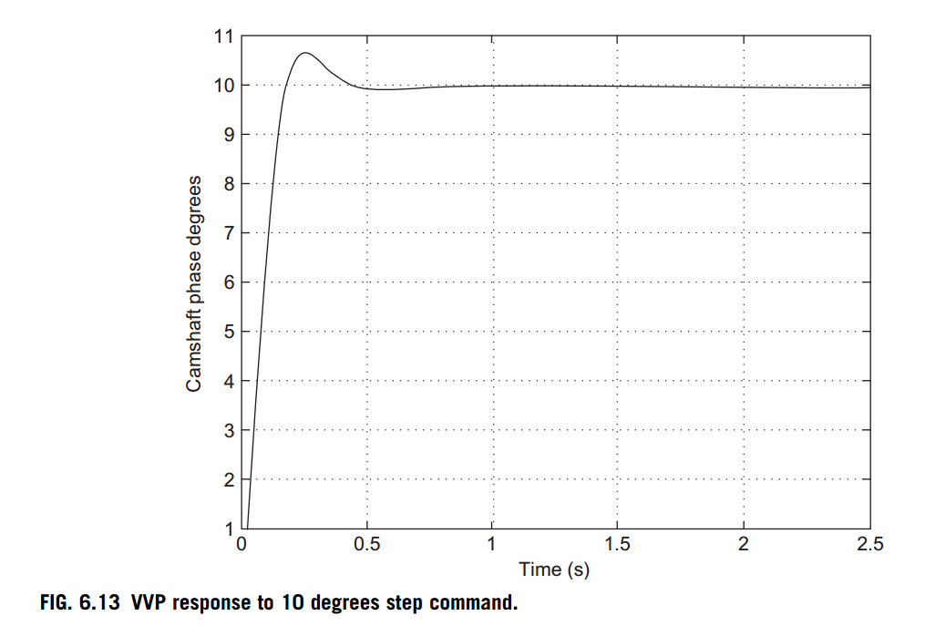
A typical output response:

Slide 32
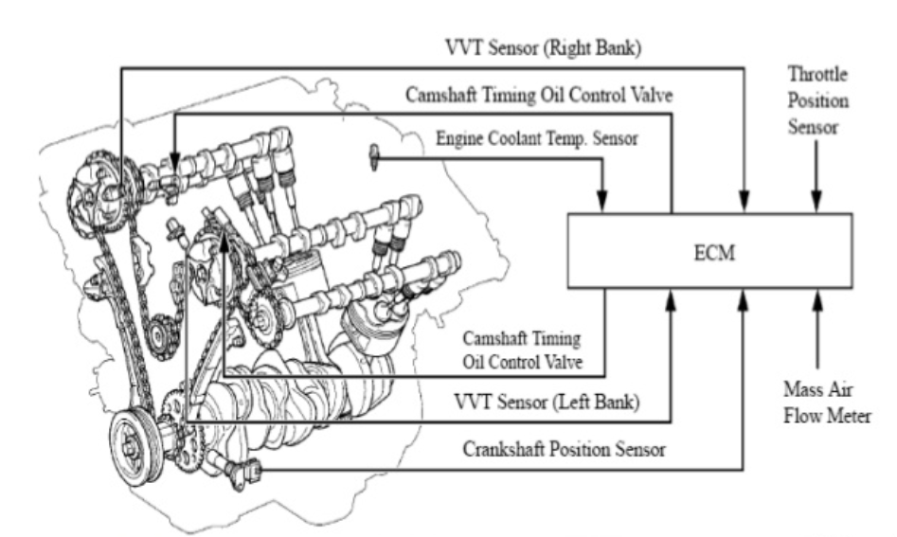
Advanced VVT System:

Slide 33
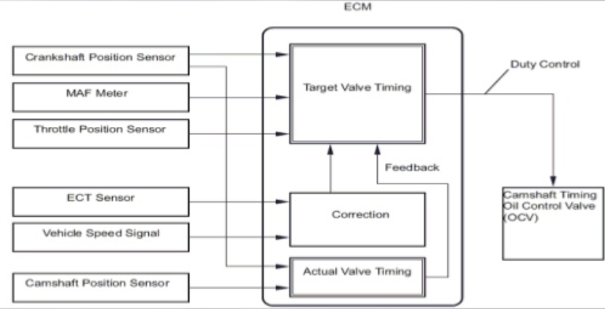
Advanced VVT System:
Cam Phasing
https://www.slideshare.net/souravbagchiprofile/variable-valve-timing?next_slideshow=1

Slide 34
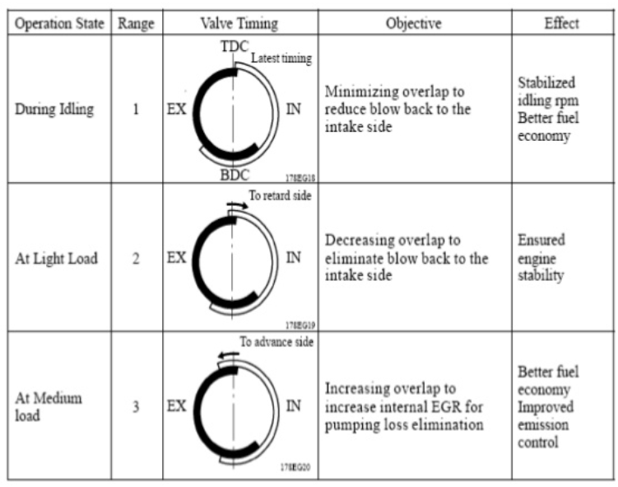
Control Logic:
https://www.slideshare.net/souravbagchiprofile/variable-valve-timing?next_slideshow=1

Slide 35
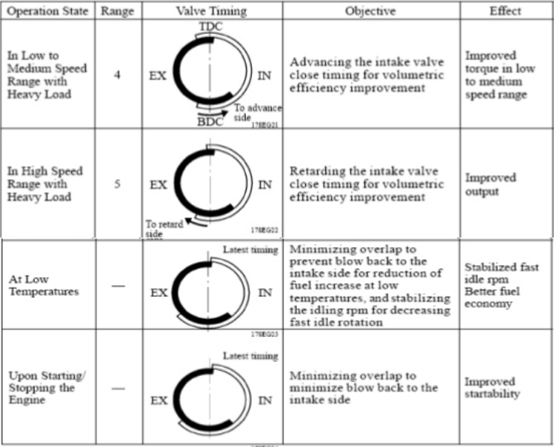
Control Logic:

Slide 36
References:
https://en.wikipedia.org/wiki/Variable_valve_timing
www.youtube.com
https://www.youtube.com/watch?v=I5dy2Vnf95w
https://www.slideshare.net/souravbagchiprofile/variable-valve-timing?next_slideshow=1
Understanding Automotive Electronics (8th Edition) by William B. Ribbens

Slide 37
https://www.youtube.com/watch?v=_7FM3sKqXvk&feature=youtu.be
http://alflash.com.ua/vvt.htm
http://kksouri.blogspot.in/2010/05/vvt-i-variable-valve-timing-intelligent.html
https://pawlikautomotive.com/vvt-variable-valve-timing/
https://www.google.co.in/search?q=spool+valve&source=lnms&tbm=isch&sa=X&ved=0ahUKEwiWjISrw6HaAhVKK48KHcNDCKgQ_AUICigB&biw=1536&bih=710#imgrc=9aorPqsM3UCp2M:
https://www.youtube.com/watch?v=ml5wltlM-cw
https://www.google.co.in/search?tbm=isch&source=hp&biw=1536&bih=759&ei=2M7EWqbkBcrQvgSy0JaQCQ&q=cam+phasing+vvt&oq=cam+phasing+vvt&gs_l=img.3...1196.5513.0.5800.0.0.0.0.0.0.0.0..0.0....0...1ac.1.64.img..0.0.0....0.gEVwOMHOJr4#imgrc=NHTn75yZxXOLcM:
https://www.google.co.in/search?hl=en&authuser=0&biw=1536&bih=759&tbm=isch&sa=1&ei=gzfEWpjLLIuV8wWJnbvwAw&q=VTEC+Cam+profiles&oq=VTEC+Cam+profiles&gs_l=psy-ab.3...27155.32285.0.32735.0.0.0.0.0.0.0.0..0.0....0...1c.1.64.psy-ab..0.0.0....0.Tnnt_dVhbJ8#imgrc=iqnAFAfJT5UD4M:

